Slide 1
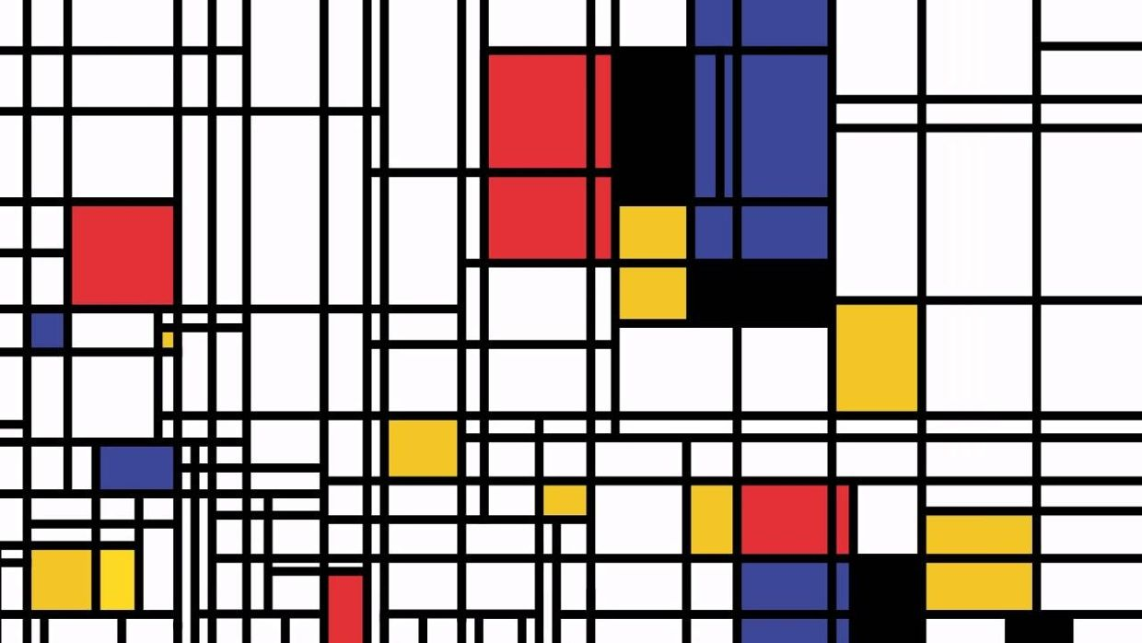
Ultra-fast read mapping with Kallisto

Slide 2
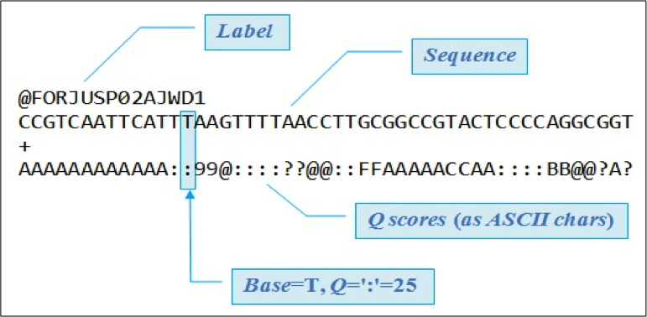
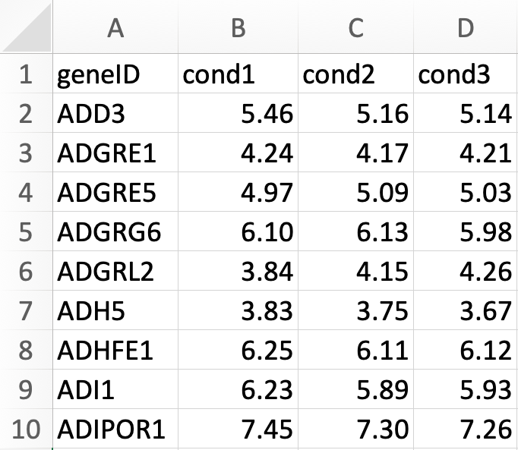
Fastq -> gene expression
Fastq
Gene expression
Kallisto
->
Notes:
Concept of an RStudio Project

Slide 3
What you should have?
You have the current version of R, RStudio, and Bioconductor
You have a basic understanding of RStudio interface and R pkgs
You know how to open Terminal (Mac) or Command Prompt (PC)
You have a code-aware text editor (Sublime and/or VS Code)
You have at least one Conda environment that contains Kallisto

Slide 4
What you should have?
Discuss the course dataset.
Download and examine a reference transcriptome from Ensembl.
Use Kallisto to construct an index from this reference file.
Use Kallisto to map our raw reads to this index
Talk a bit about how an index is built and facilitates read alignment

Slide 5
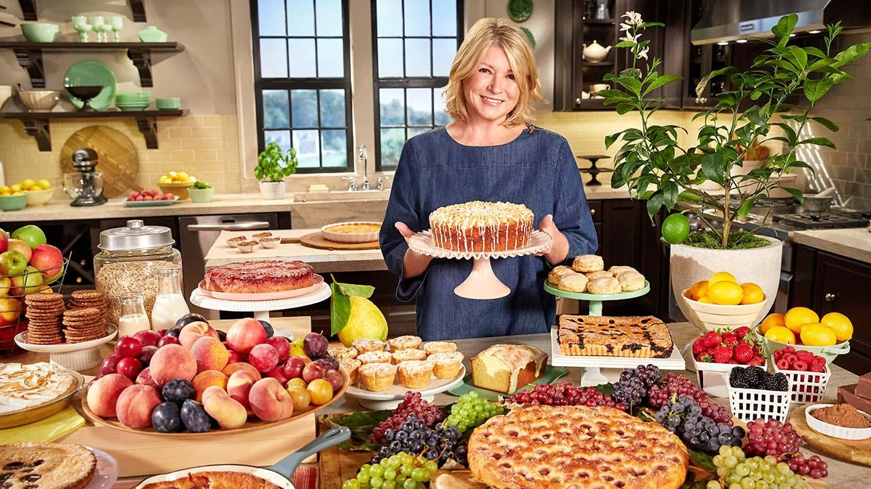

Slide 6
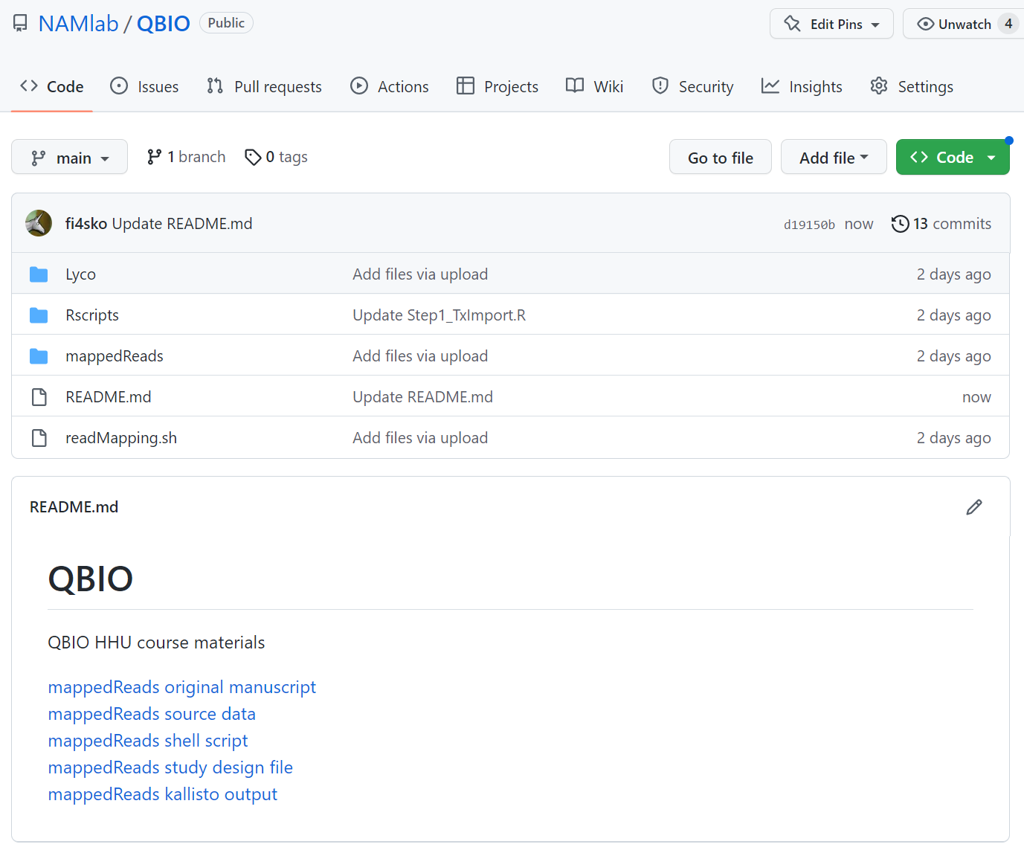
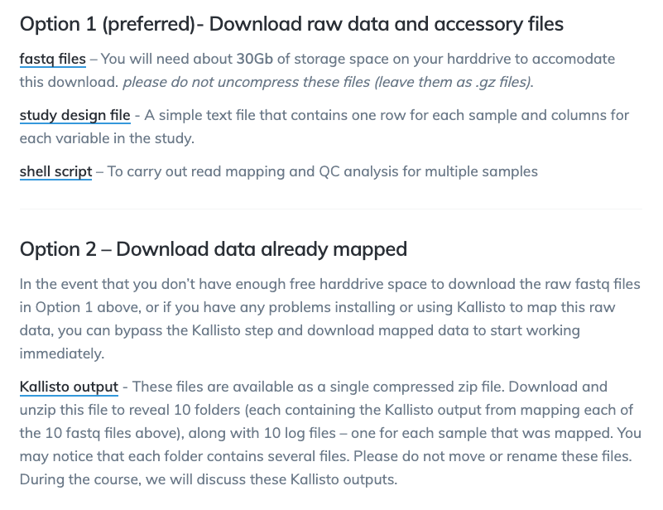
Our dataset
Notes:
Concept of an RStudio Project

Slide 7
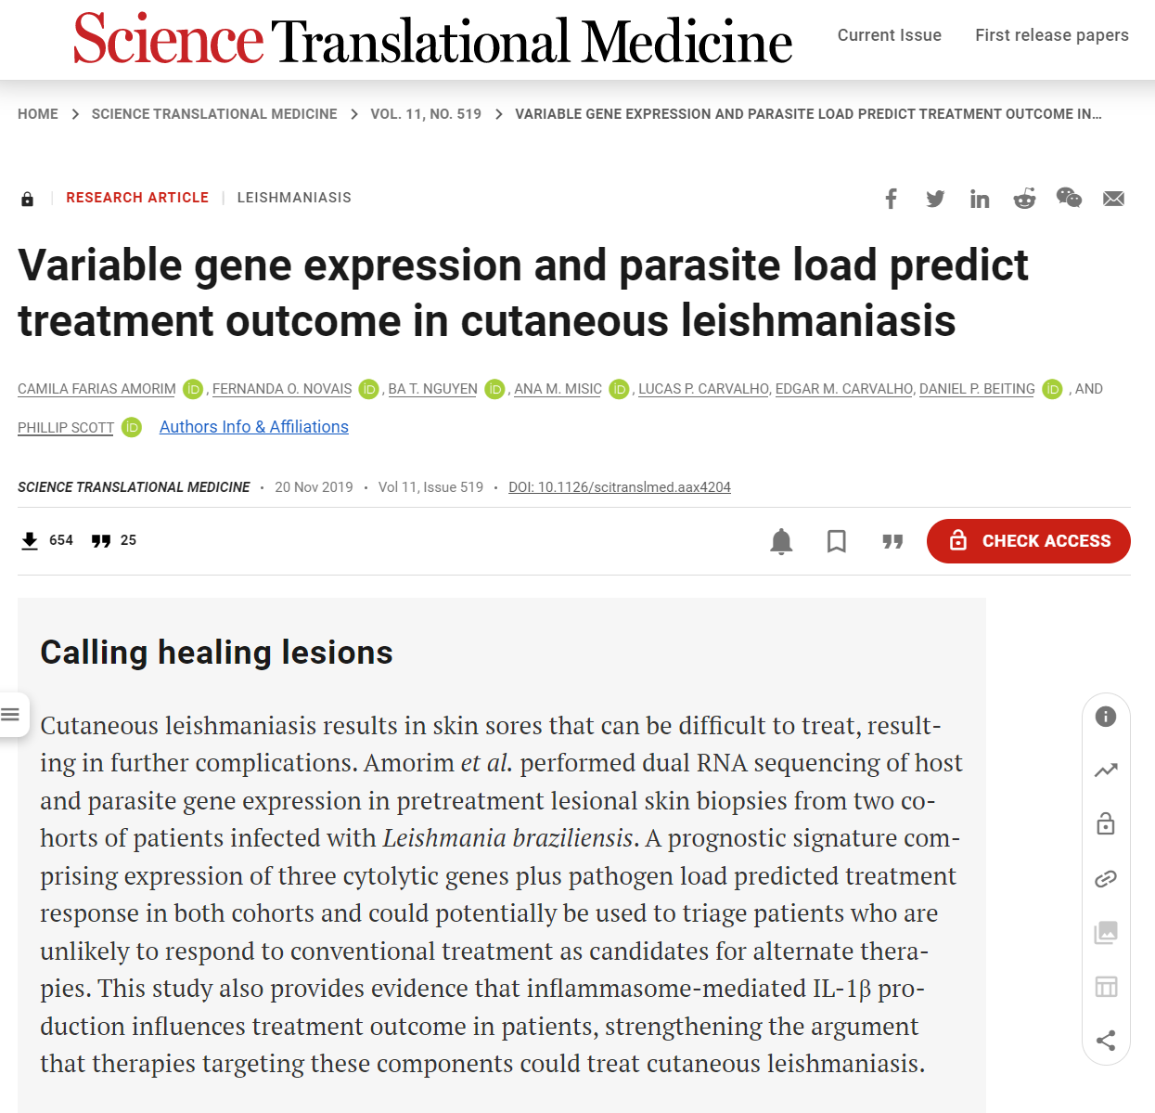
Our dataset
RNAseq from patients with cutaneous leishmaniasis
skin biopsies
a parasitic disease endemic in South America
Leishmania braziliensis - protozoan
neglected tropical disease
infected sandlfy is a vector of a parasite
skin lesions/ulcers
data from 5 patients with this disease and 5 healthy endemic controls
Notes:
Concept of an RStudio Project

Slide 8

Our dataset
RNAseq from patients with cutaneous leishmaniasis
skin biopsies
a parasitic disease endemic in South America
Leishmania braziliensis - protozoan
neglected tropical disease
infected sandlfy is a vector of a parasite
skin lesions/ulcers
data from 5 patients with this disease and 5 healthy endemic controls
Notes:
Concept of an RStudio Project

Slide 9
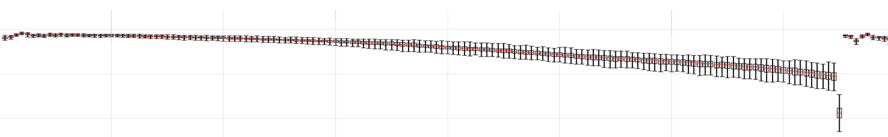
Read quality
Fastq
ASCII characters
! | “ | # | $ | % | & | ‘ | ( | ) | * | + | , | - | . | / | 0 | 1 | 2 | 3 | 4 | 5 | 6 | 7 | 8 | 9 | : | ; | < | = | > | ? | @ | A | B | C | D | E | F | G | H | I
0 | 1 | 2 | 3 | 4 | 5 | 6 | 7 | 8 | 9 | 10 | 11 | 12 | 13 | 14 | 15 | 16 | 17 | 18 | 19 | 20 | 21 | 22 | 23 | 24 | 25 | 26 | 27 | 28 | 29 | 30 | 31 | 32 | 33 | 34 | 35 | 36 | 37 | 38 | 39 | 40
Quality score
Assess the quality of your raw data before moving forward with analysis
% bases >Q30
100
60
Cycle #

Slide 10
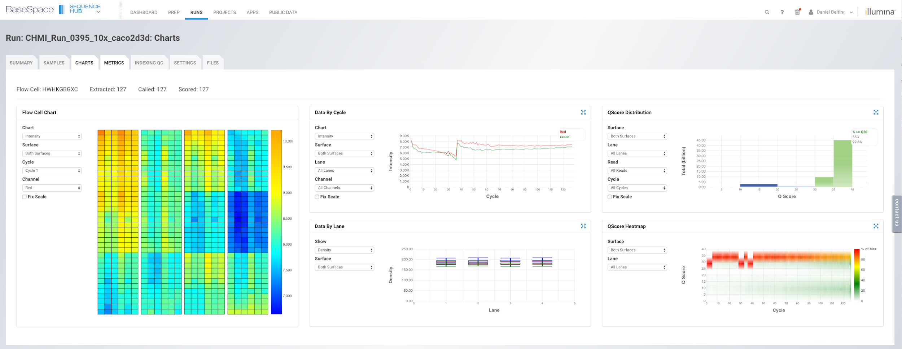
Quality assessment via Illumina’s BaseSpace

Slide 11
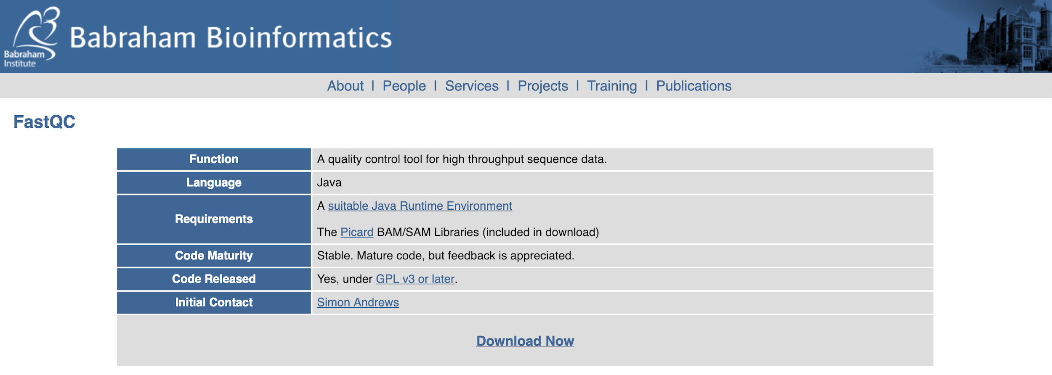
Quality assessment of fastq files using fastqc
https://www.bioinformatics.babraham.ac.uk/projects/fastqc/

Slide 12
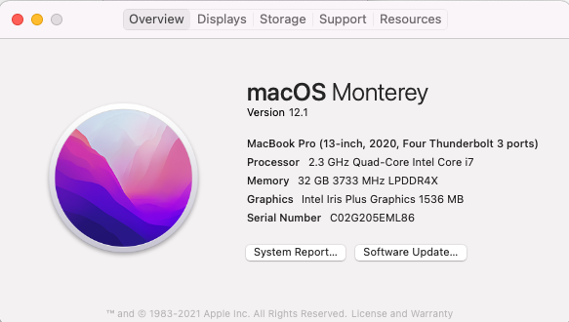
Quality assessment of fastq files using fastqc
https://www.bioinformatics.babraham.ac.uk/projects/fastqc/

Slide 13
Fastq -> gene expression
Fastq
Gene expression
Kallisto
->
Notes:
Concept of an RStudio Project

Slide 14
Ingredients for an alignment
our data
(or your data)
reference
sequences
.fastq
.fasta
Find your reference sequences at:
http://www.ensembl.org/info/data/ftp/index.html
https://plants.ensembl.org/info/data/ftp/index.html

Slide 15
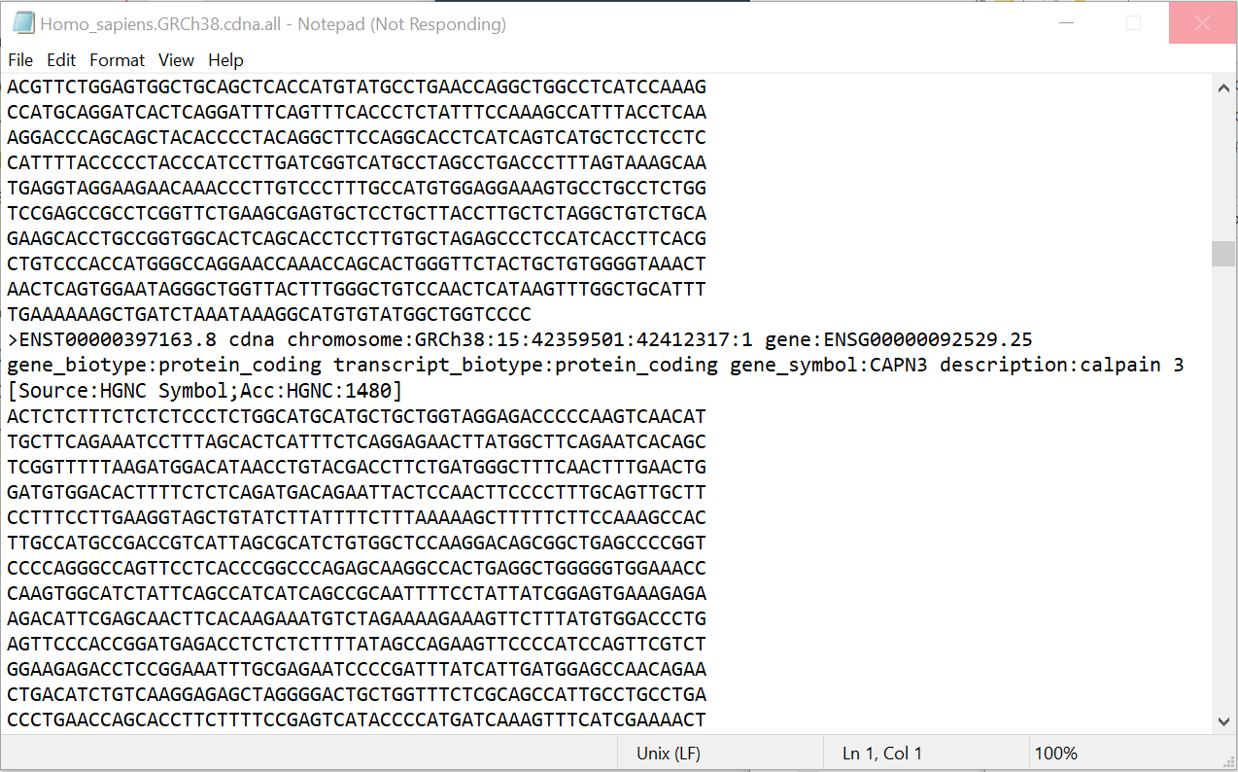
Ingredients for an alignment
reference
sequences
.fasta

Slide 16
Ingredients for an alignment
our data
(or your data)
reference
sequences
index
.fastq
.fasta

Slide 17
Building an index
Open a terminal (Mac) or Command Prompt (Windows)
Activate your ‘rnaseq’ conda environment
Use Kallisto to build index from reference fasta
kallisto index -i inputFastaName.index inputFastaName.fa
kallisto index -i Homo_sapiens.GRCh38.cdna.all.index Homo_sapiens.GRCh38.cdna.all.fa
Only need to build an index once
Be careful with file names!
Long and meaningful file names are better than short ambiguous ones.
No spaces. ‘my_file_name’, or ’myFileName’, or ‘my.file.name’….just not, ‘my file name’
Let’s construct an index from our reference fasta file

Slide 18
Mapping single-end data
Calling the program and function
Code continues on next line
Name and path of index
Name of output folder
kallisto quant \
-i Homo_sapiens.GRCh38.cdna.all.index \
-o test \
-t 8 \
--single -l 250 -s 30 \
SRR8668755_1M_subsample.fastq.gz
Number of threads to use
Single vs paired-end and fragment size
Name of fastq file to be mapped

Slide 19
Mapping single-end data
Calling the program and function
Code continues on next line
Name and path of index
Name of output folder
kallisto quant \
-i Homo_sapiens.GRCh38.cdna.all.index \
-o test \
-t 8 \
--single -l 250 -s 30 \
SRR8668755_1M_subsample.fastq.gz
&> test.log
Number of threads to use
Single vs paired-end and fragment size
Name of fastq file to be mapped

Slide 20
Mapping paired-end data
Calling the program and function
Code continues on next line
Name and path of index
Name of output folder
kallisto quant \
-i Homo_sapiens.GRCh38.cdna.all.index \
-o test \
-t 8 \
sample1_read1.fq.gz \
sample1_read2.fq.gz \
&> test.log
Number of threads to use
Name of read1 fastq file
Name of read2 fastq file

Slide 21
Kallisto demonstration
kallisto quant \
-i Homo_sapiens.GRCh38.cdna.all.index \
-o test \
-t 8 \
--single -l 250 -s 30 \
SRR8668755_1M_subsample.fastq.gz

Slide 22
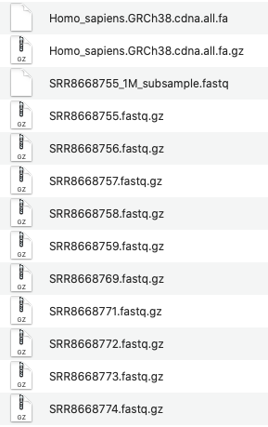
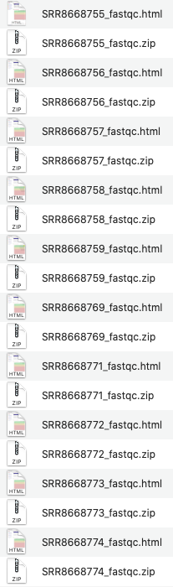
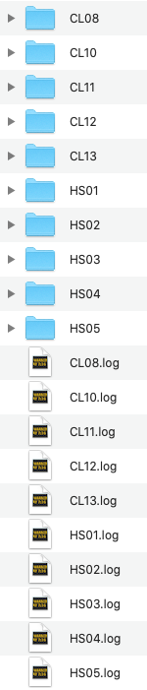
Pulling it all together
Fastq files
Fastqc/fastp outputs
Kallisto outputs

Slide 23


Summarize outputs with multiQC
Easy to run: multiqc -d .
https://multiqc.info/

Slide 24
MultiQC demonstration
(Again, need to be in the appropriate conda environment!)

Slide 25
Summarize outputs with multiQC
Easy to run: multiqc -d .
https://multiqc.info/

Slide 26
End of part 2

Slide 27

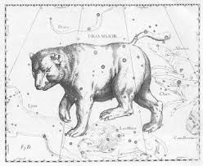

How do we automate for many fastq files?
Quality assurance
Index construction
Summarize outputs
+
Read mapping
None of this used R/bioconductor

Slide 28
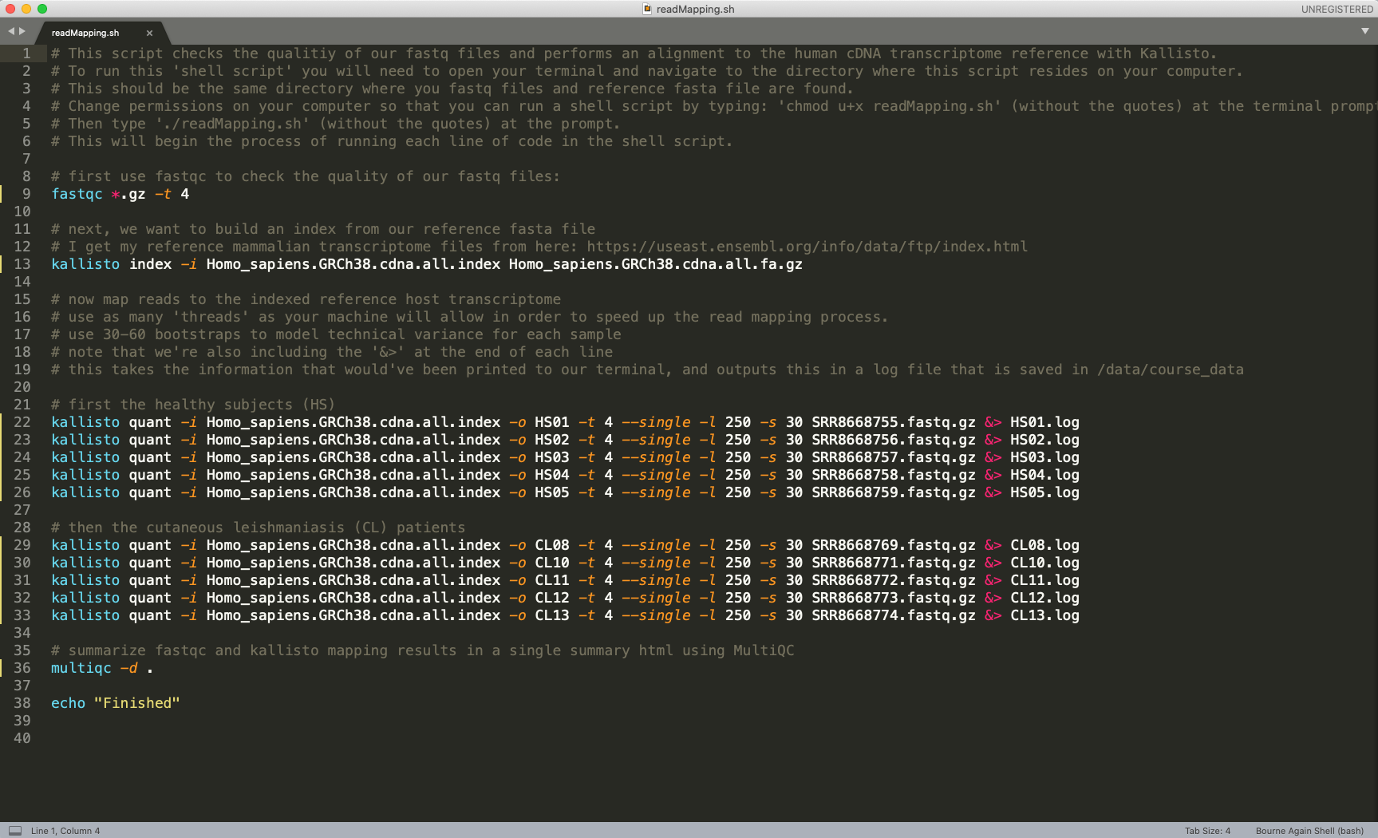
Automate using shell scripts
readMapping.sh
kallisto quant \
-i Homo_sapiens.GRCh38.cdna.all.index \
-o test \
-t 4 \
--single -l 250 -s 30 \
SRR8668755_1M_subsample.fastq

Slide 29
Pulling it all together
Fastq files
Kallisto outputs
Fastqc outputs

Slide 30
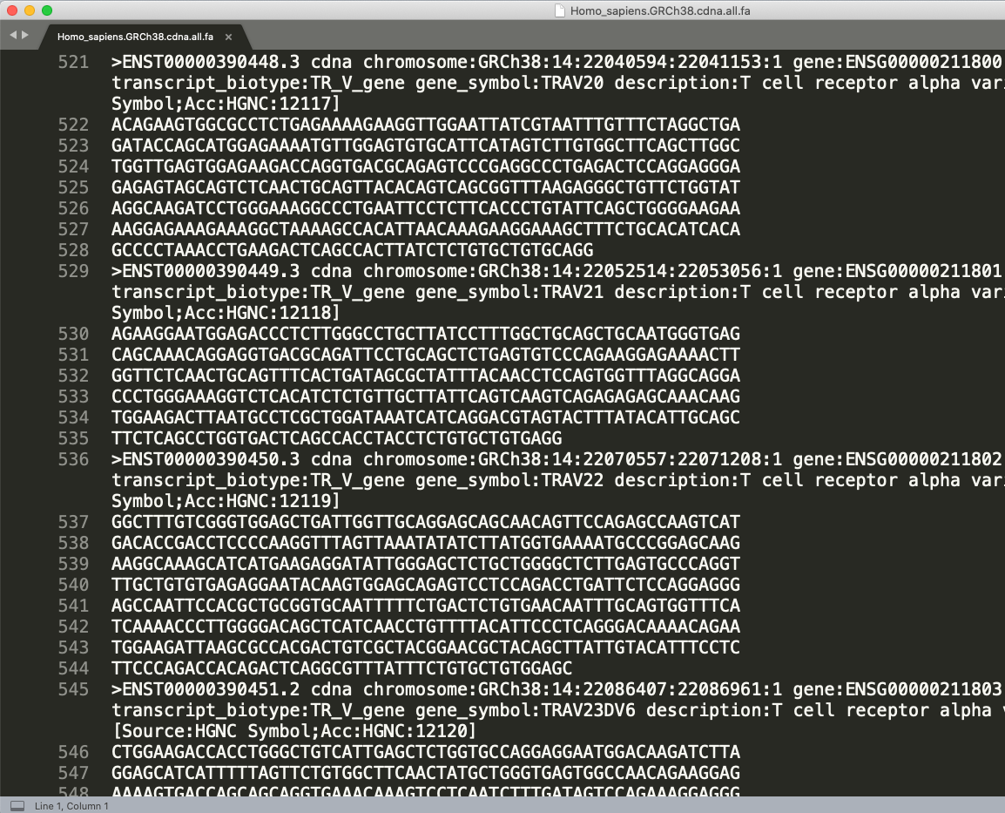
Read mapping is text pattern matching
Fastq
Notes:
Concept of an RStudio Project

Slide 31
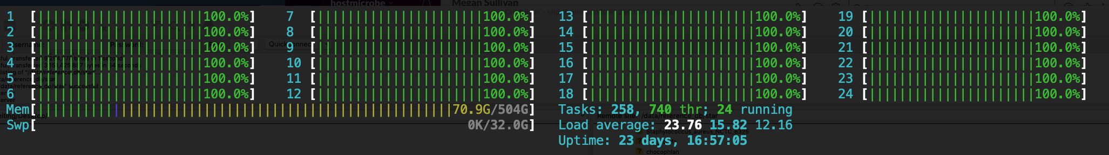
The compute resources needed for index construction vary depending on the aligner
Example of index construction using STAR
Final indexes built with STAR

Slide 32
Burrows-Wheeler Transform (BWT)
‘tattletales’
t | a | t | t | l | e | t | a | l | e | s | $
a | t | t | l | e | t | a | l | e | s | $ | t
t | t | l | e | t | a | l | e | s | $ | t | a
t | l | e | t | a | l | e | s | $ | t | a | t
l | e | t | a | l | e | s | $ | t | a | t | t
e | t | a | l | e | s | $ | t | a | t | t | l
t | a | l | e | s | $ | t | a | t | t | l | e
a | l | e | s | $ | t | a | t | t | l | e | t
l | e | s | $ | t | a | t | t | l | e | t | a
e | s | $ | t | a | t | t | l | e | t | a | l
s | $ | t | a | t | t | l | e | t | a | l | e
$ | t | a | t | t | l | e | t | a | l | e | s
Sort rows lexiographically based on first column

Slide 33
Burrows-Wheeler Transform (BWT)
‘tattletales’
12
$ | t | a | t | t | l | e | t | a | l | e | s
a | l | e | s | $ | t | a | t | t | l | e | t
a | t | t | l | e | t | a | l | e | s | $ | t
e | s | $ | t | a | t | t | l | e | t | a | l
e | t | a | l | e | s | $ | t | a | t | t | l
l | e | s | $ | t | a | t | t | l | e | t | a
l | e | t | a | l | e | s | $ | t | a | t | t
s | $ | t | a | t | t | l | e | t | a | l | e
t | a | l | e | s | $ | t | a | t | t | l | e
t | a | t | t | l | e | t | a | l | e | s | $
t | l | e | t | a | l | e | s | $ | t | a | t
t | t | l | e | t | a | l | e | s | $ | t | a
8
2
10
6
9
5
11
7
1
4
3

Slide 34
Burrows-Wheeler Transform (BWT)
‘tattletales’
First
Last
$ | t | a | t | t | l | e | t | a | l | e | s
a | l | e | s | $ | t | a | t | t | l | e | t
a | t | t | l | e | t | a | l | e | s | $ | t
e | s | $ | t | a | t | t | l | e | t | a | l
e | t | a | l | e | s | $ | t | a | t | t | l
l | e | s | $ | t | a | t | t | l | e | t | a
l | e | t | a | l | e | s | $ | t | a | t | t
s | $ | t | a | t | t | l | e | t | a | l | e
t | a | l | e | s | $ | t | a | t | t | l | e
t | a | t | t | l | e | t | a | l | e | s | $
t | l | e | t | a | l | e | s | $ | t | a | t
t | t | l | e | t | a | l | e | s | $ | t | a
12
$ | t | a | t | t | l | e | t | a | l | e | s
a | l | e | s | $ | t | a | t | t | l | e | t
a | t | t | l | e | t | a | l | e | s | $ | t
e | s | $ | t | a | t | t | l | e | t | a | l
e | t | a | l | e | s | $ | t | a | t | t | l
l | e | s | $ | t | a | t | t | l | e | t | a
l | e | t | a | l | e | s | $ | t | a | t | t
s | $ | t | a | t | t | l | e | t | a | l | e
t | a | l | e | s | $ | t | a | t | t | l | e
t | a | t | t | l | e | t | a | l | e | s | $
t | l | e | t | a | l | e | s | $ | t | a | t
t | t | l | e | t | a | l | e | s | $ | t | a
8
2
10
tattletales
6
9
BWT
5
11
sttllatee$ta
7
1
4
3

Slide 35
Burrows-Wheeler Transform (BWT)
‘tattletales’
First
Last
12
$ | t | a | t | t | l | e | t | a | l | e | s
a | l | e | s | $ | t | a | t | t | l | e | t
a | t | t | l | e | t | a | l | e | s | $ | t
e | s | $ | t | a | t | t | l | e | t | a | l
e | t | a | l | e | s | $ | t | a | t | t | l
l | e | s | $ | t | a | t | t | l | e | t | a
l | e | t | a | l | e | s | $ | t | a | t | t
s | $ | t | a | t | t | l | e | t | a | l | e
t | a | l | e | s | $ | t | a | t | t | l | e
t | a | t | t | l | e | t | a | l | e | s | $
t | l | e | t | a | l | e | s | $ | t | a | t
t | t | l | e | t | a | l | e | s | $ | t | a
8
₄
2
₁
10
6
9
5
₃
11
7
₄
1
₁
4
₃
₂
3
₂

Slide 36

Burrows-Wheeler Transform (BWT)
‘tattletales’
7
First
Last
12
$ | t | a | t | t | l | e | t | a | l | e | s
a | l | e | s | $ | t | a | t | t | l | e | t
a | t | t | l | e | t | a | l | e | s | $ | t
e | s | $ | t | a | t | t | l | e | t | a | l
e | t | a | l | e | s | $ | t | a | t | t | l
l | e | s | $ | t | a | t | t | l | e | t | a
l | e | t | a | l | e | s | $ | t | a | t | t
s | $ | t | a | t | t | l | e | t | a | l | e
t | a | l | e | s | $ | t | a | t | t | l | e
t | a | t | t | l | e | t | a | l | e | s | $
t | l | e | t | a | l | e | s | $ | t | a | t
t | t | l | e | t | a | l | e | s | $ | t | a
₁
₁
8
₂
₄
2
₁
₁
10
₂
₂
6
₁
₁
Search for ‘tale'
9
₂
₂
5
₁
₃
11
₁
₂
7
₄
₁
1
₁
₁
4
₃
₂
3
₂
₁

Slide 37
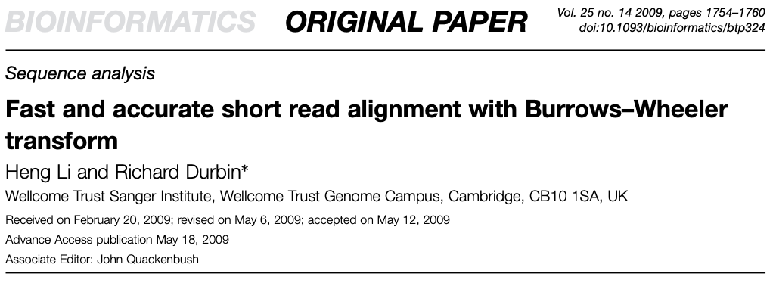
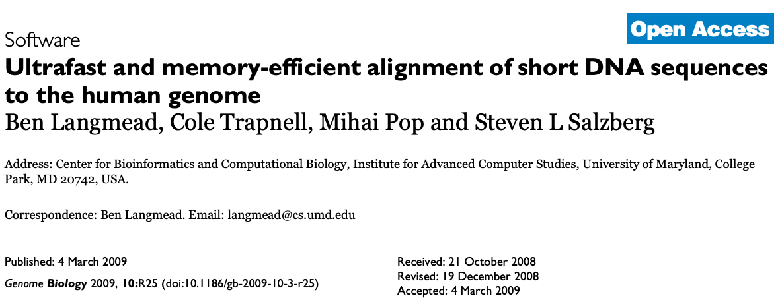
Application of BWT in genomics
~23,000 citations
~16,000 citations

Slide 38
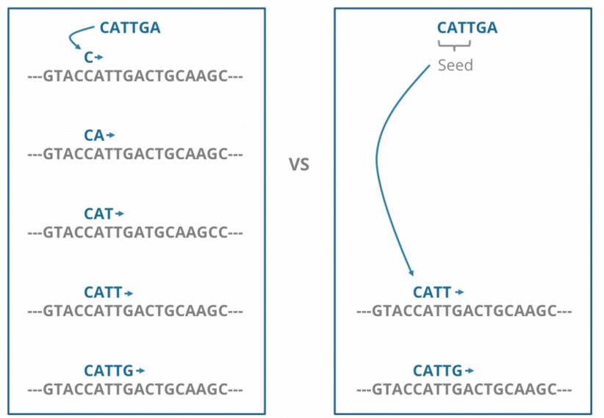
‘Seed and Extend’ alignments
extension only
seed -> extend
brute force, but slow
fast(er)
https://blog.sbgenomics.com/short-read-alignment-seeding/
Notes:
Problems that alignment algorithms face:
trade-off between speed and accuracy
reads are short
there is some inherent error rate with all sequencing platforms
think about how your choice of reference (genome vs. transcriptome) influences these issues?

Slide 39
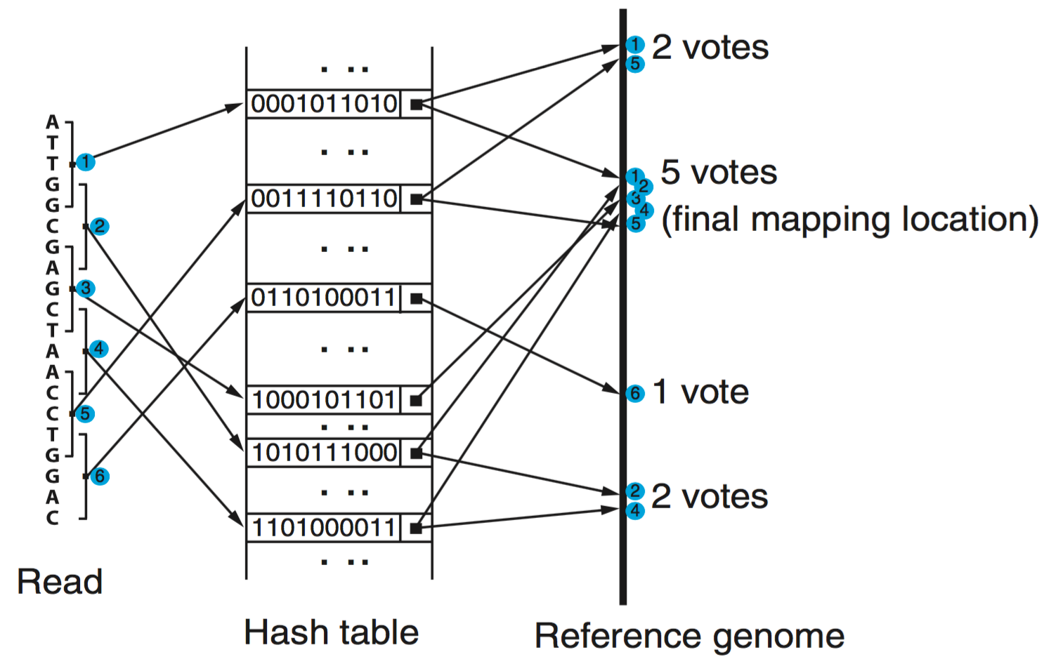
R
Subread aligner
Liao et al., NAR, 2013

Slide 40
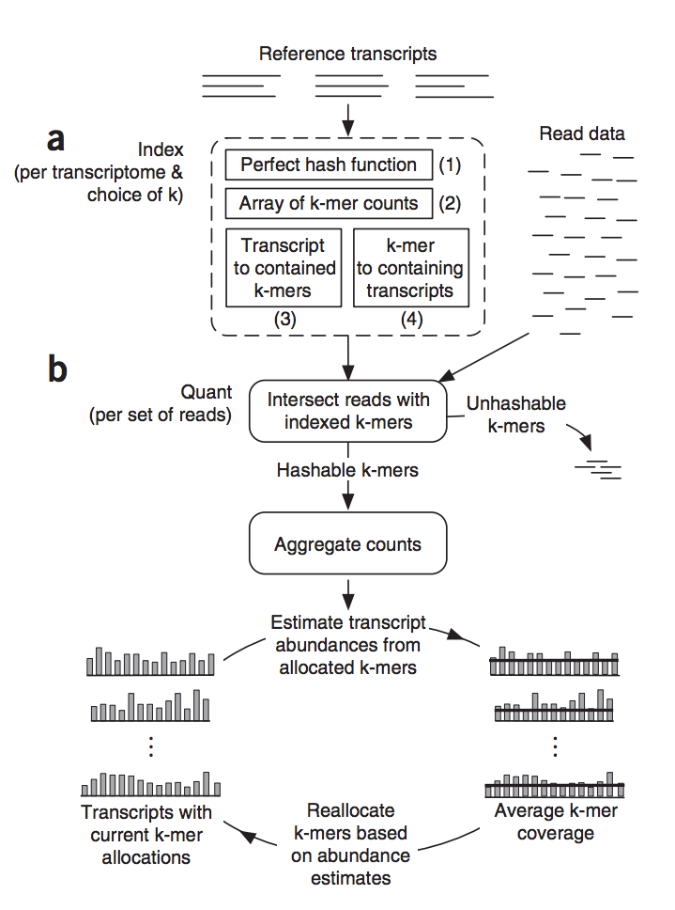
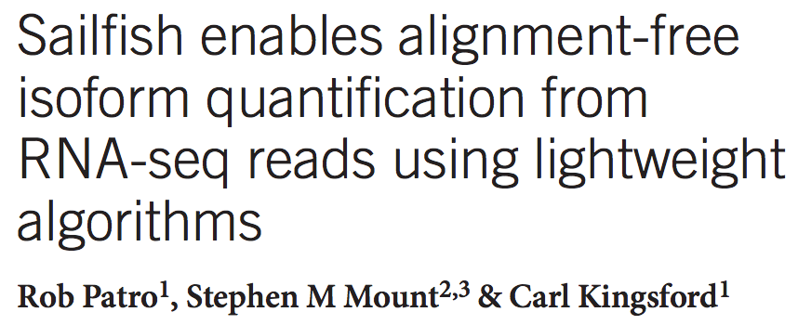
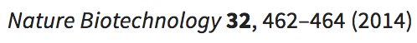
Reads are hard to align, but that’s a function of their length. Why not approach the problem by shredding reads into Kmers - enter “Sailfish”
Sailfish replaces approximate alignment of (error prone) reads with exact alignment of short k-mers

Slide 41
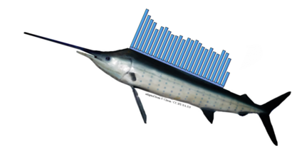
Sailfish
‘lightweight read alignment’
“By not requiring read mapping, Sailfish avoids parameters specifying, for example, the number of mismatches to tolerate, total allowable quality of mismatched bases, gap open and extension penalties, whether and how much to trim reads, number and quality of alignments to report from the aligner and pass into the estimation procedure.”
Patro et al., Nat. Biotech., 2014

Slide 42
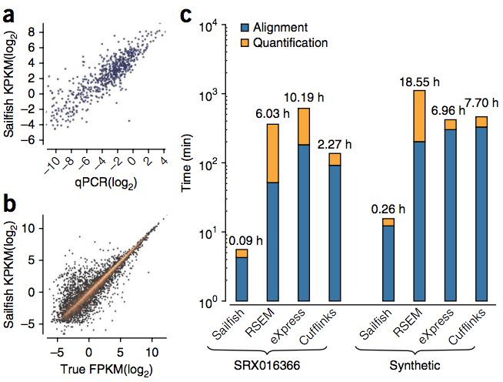
Sailfish
‘lightweight read alignment’
Patro et al., Nat. Biotech., 2014

Slide 43
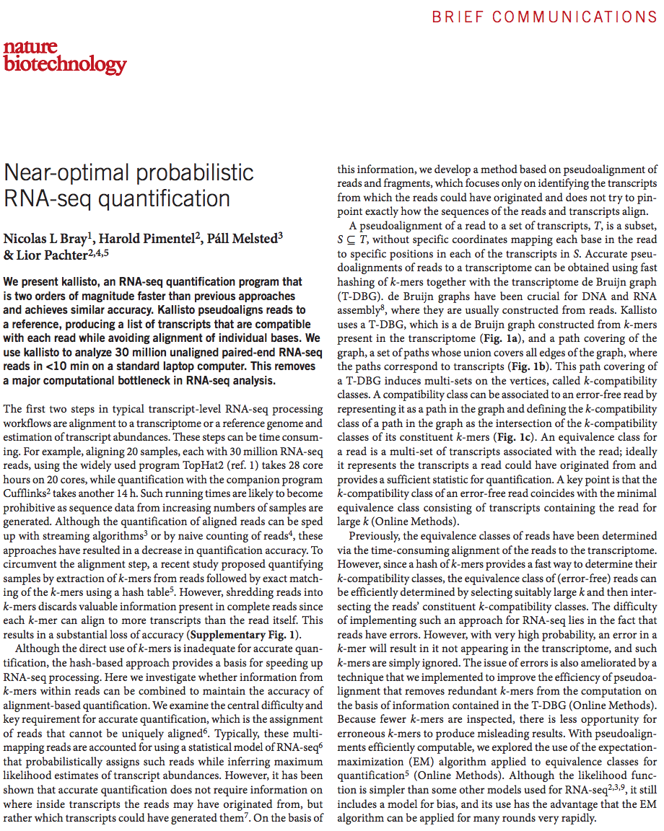
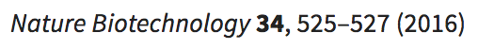
What if the idea of alignment was altogether abandoned enter “Kallisto”

Slide 44
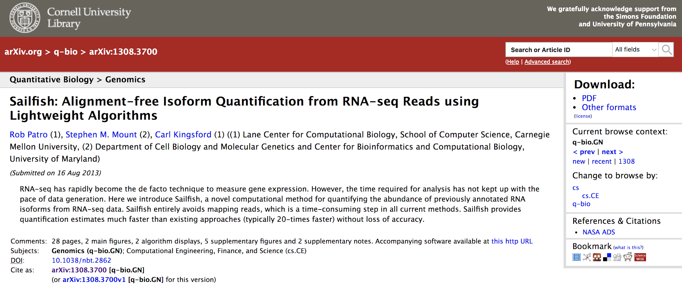
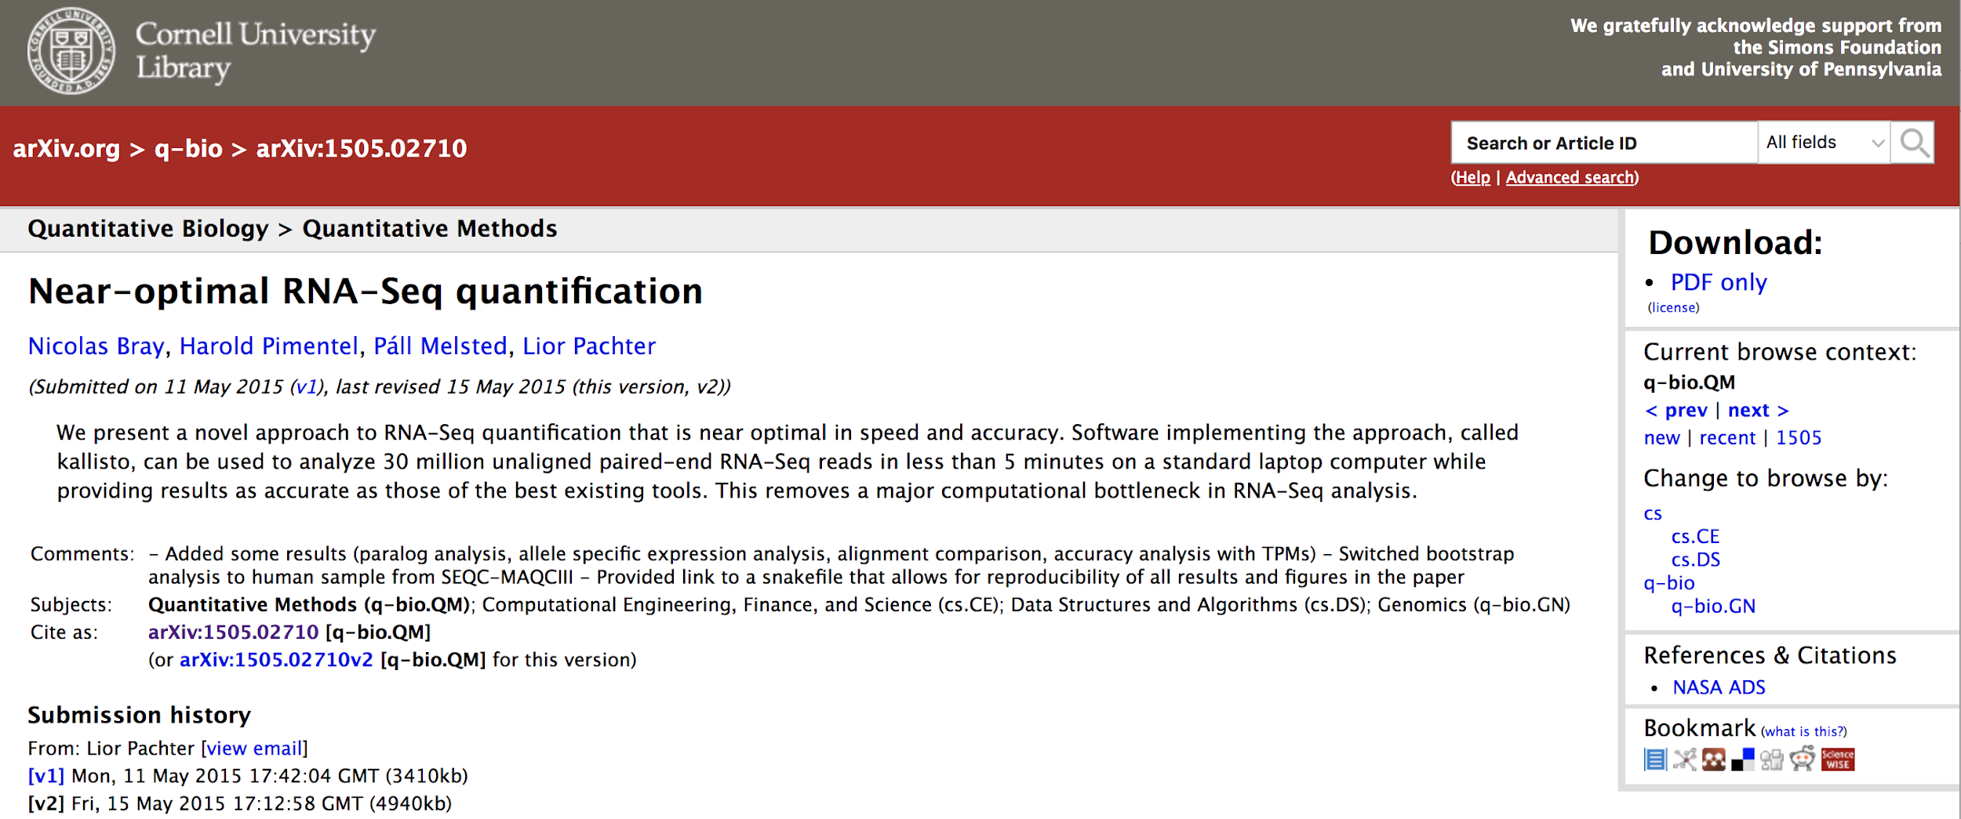

Slide 45
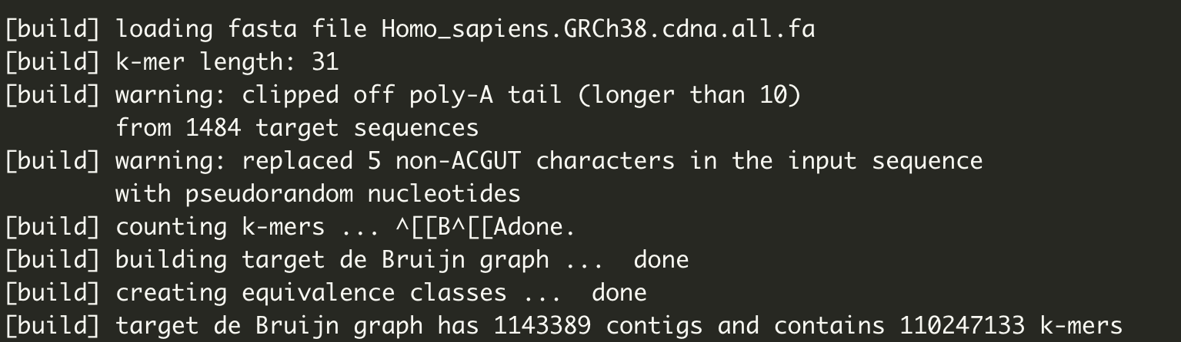
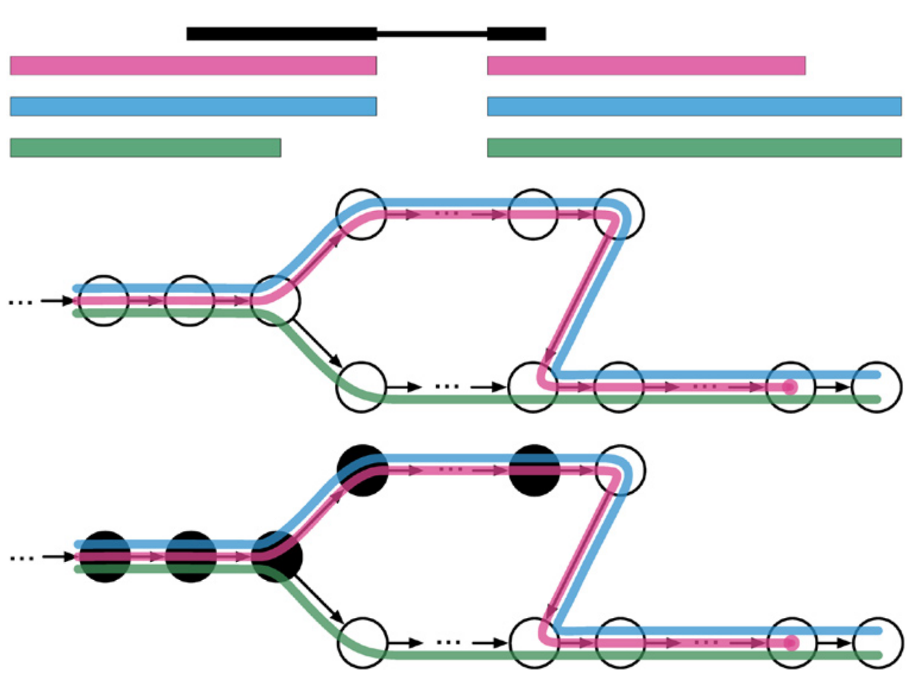
mapping reads with Kallisto
create transcriptome de Bruijn graph (T-DBG)
using k-mers (31 nucleotides)
Bray et al., Nat. Biotech., 2016
Notes:
Each node the the T-DBG represents a Kmer (default is 31nt)

Slide 46
mapping reads with Kallisto
Don’t align, instead find transcripts that are compatible with the read
Bray et al., Nat. Biotech., 2016

Slide 47
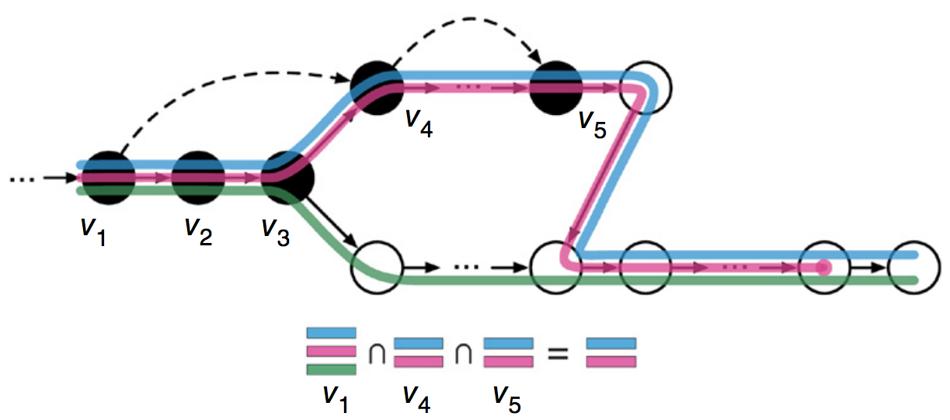
mapping reads with Kallisto
Don’t even need to search for all possible K-mers
skip
intersection of non-skipped nodes in the T-DBG assigns read to transcript(s)
Bray et al., Nat. Biotech., 2016
Notes:
When kallisto hashes a read k-mer to the T-DBG, it looks up the k-compatibility class of the node and then “skips” to the node that is after the last node in the same equivalence class.
from the Kallisto paper:
…all k-mers in a contig of the T-DBG have the same k-compatibility class, they will not affect the intersection and therefore looking them up in the hash provides no new information.
This effectively speeds up kallisto since it performs less hash lookups (in this example we only had to perform 3 hash lookups instead of

Slide 48
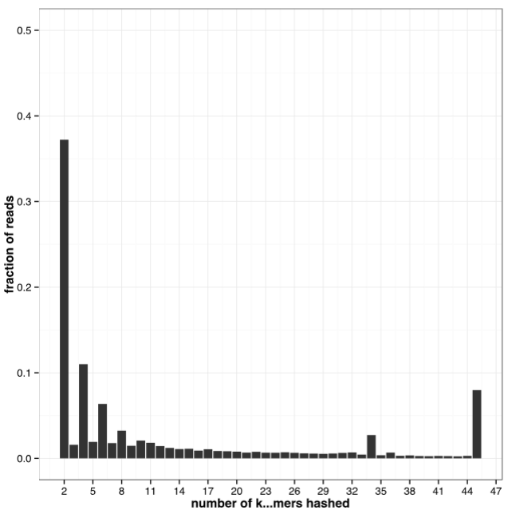
mapping reads with Kallisto
For most reads, only two k-mers were hashed b/c all k-mers from the entire read mapped to a contiguous region in the T-DBG
Bray et al., Nat. Biotech., 2016

Slide 49
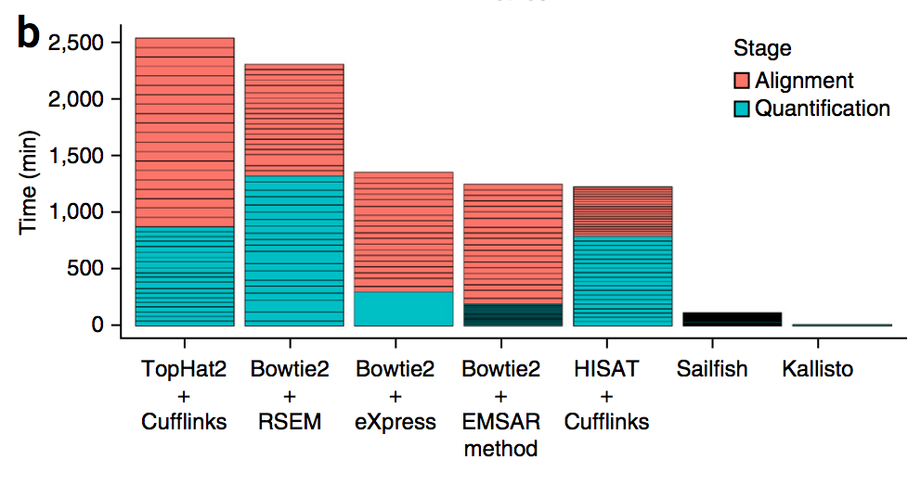
Kallisto - it’s fast
20 samples
30 million PE reads/sample
20 cores
11.47 min
Bray et al., Nat. Biotech., 2016

Slide 50
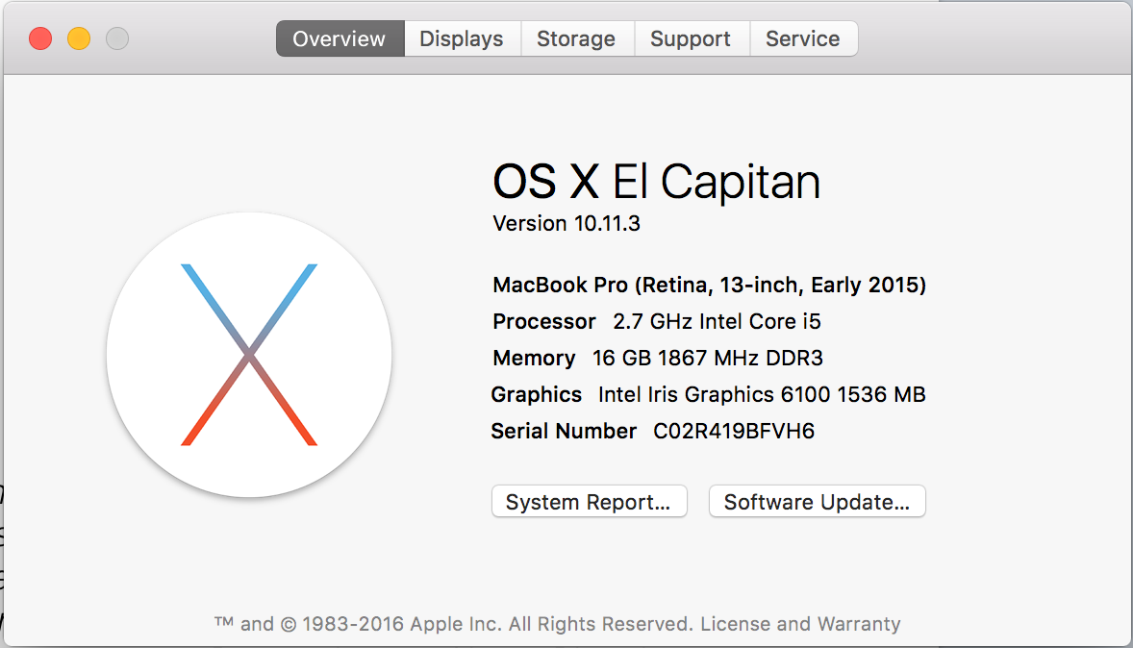
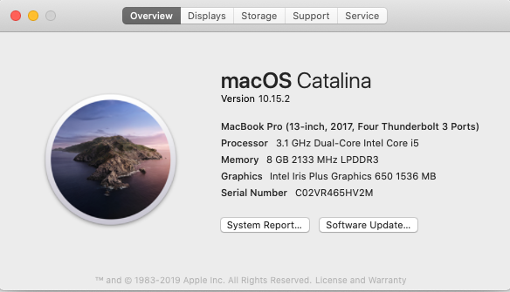
“This allows Kallisto to process 30 million [reads] in less than 10 min on a small laptop with a 1.3-GHz processor, demonstrating that with Kallisto, RNA-seq analysis of even large data sets is tractable on non-specialized hardware.”
- Bray et al., 2016, Nature Biotech.
Bray et al., Nat. Biotech., 2016

Slide 51
Kallisto - it’s fast
20 samples
30 million PE reads/sample
20 cores
“A simple word count of the sample data took 1 min 15 sec, providing a lower bound on the speed with which mapping could be performed.”
When I use 24 threads, 500Gb RAM, it takes 2min to map 47 million reads without any bootstraps. Thirty bootstraps takes 4.5 min
What is possible with such a fast aligner?
11.47 min
Notes:
Why is the time component important
- problems with scaling as datasets get larger
- access to core compute resources significantly raises the hurdle to data analysis (and re-analysis!)
- speed of Kallisto is what makes bootstrapping possible

Slide 52
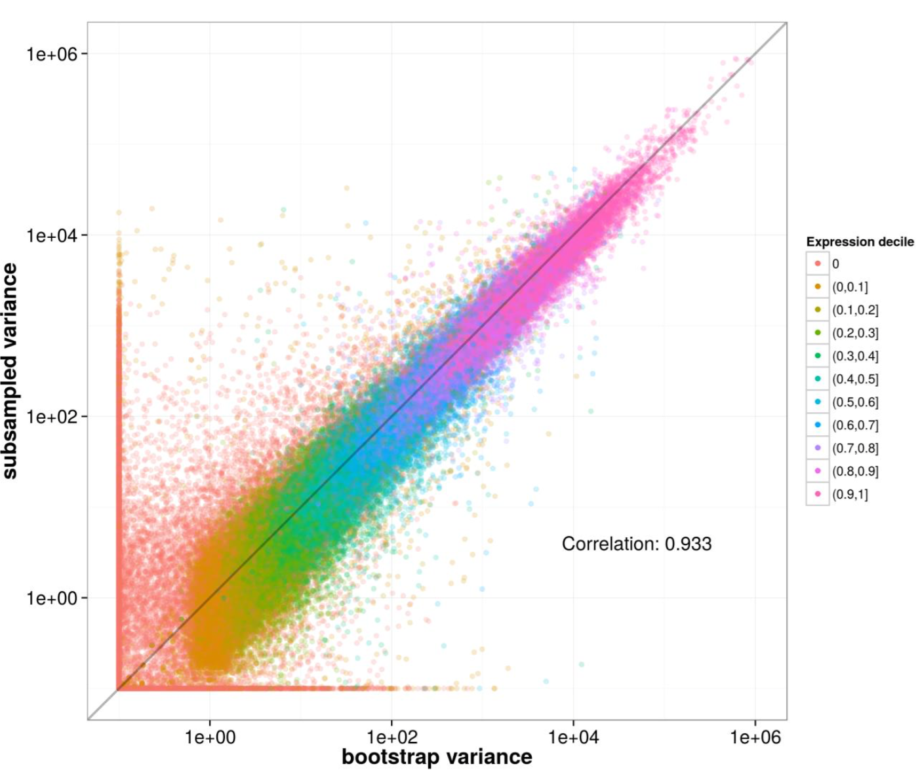
Kallisto bootstraps ( -b)
single library of 216 million reads
30mil reads subsampled 40 times
variance for 40 subsamples of 30 million reads
variance for 40 bootstraps of 1 subsample
Notes:
40 samples of 30 million reads subsampled from 275 million rat RNA-Seq reads

Slide 53
“The implication for biologists is that RNA-Seq analysis now becomes interactive. Instead of “freezing” an analysis that might take weeks or even months, data can be explored dynamically, e.g. easily quantified against different transcriptomes, or re-quantified as transcriptomes are updated. The ability to analyze data locally instead of requiring cloud computation means that analysis is portable, and also easily secure.”
- Lior Pachter, Bits of DNA blog, 2015.
“The implication for biologists is that RNA-Seq analysis now becomes interactive. Instead of “freezing” an analysis that might take weeks or even months, data can be explored dynamically, e.g. easily quantified against different transcriptomes, or re-quantified as transcriptomes are updated. The ability to analyze data locally instead of requiring cloud computation means that analysis is portable, and also easily secure.”
- Lior Pachter, Bits of DNA blog, 2015.

